Slide 1
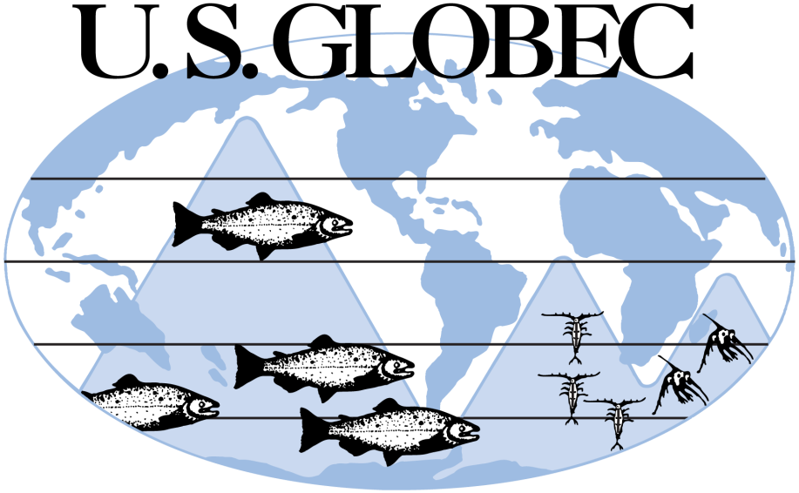

A View from Ocean Leadership:
The Challenges Ahead in Washington
Bob Gagosian, The Consortium for Ocean Leadership

